Slide 1
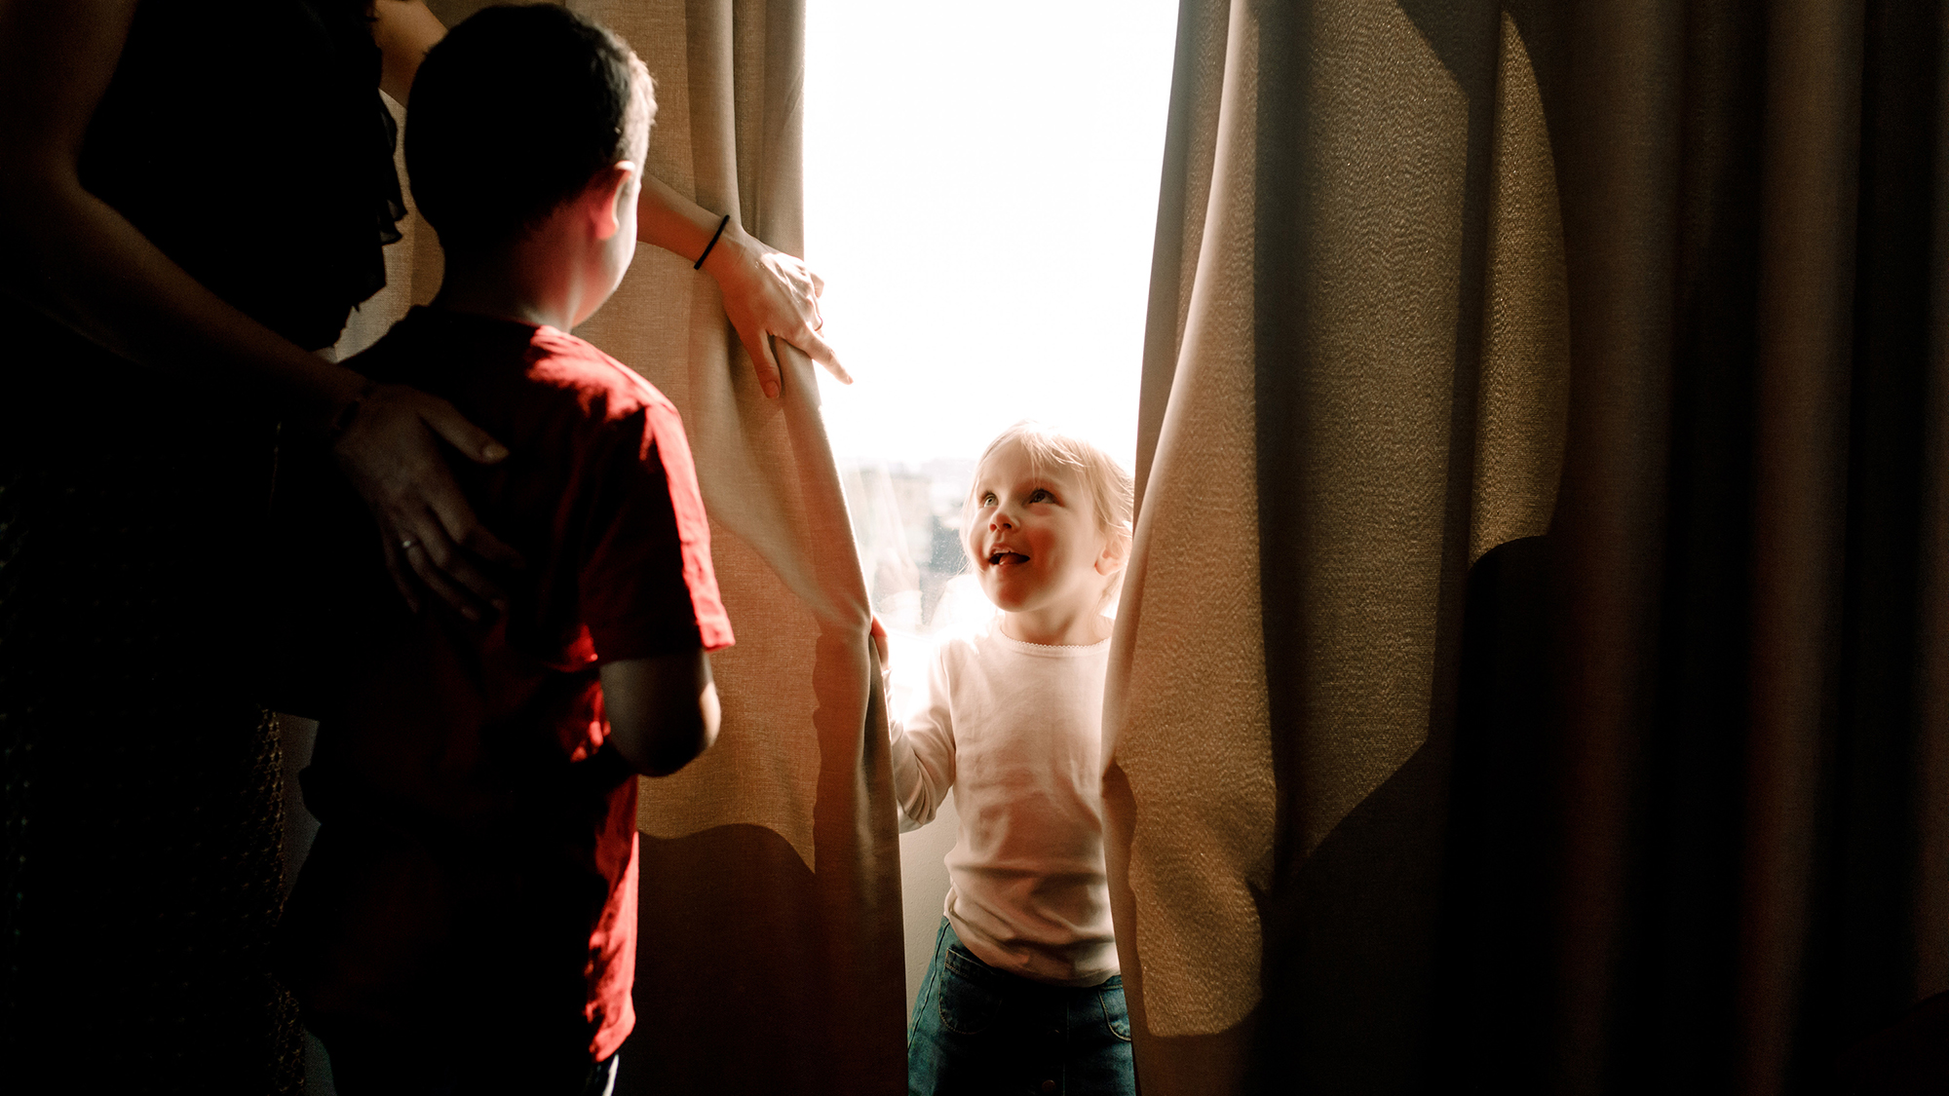
Inside Lives Longitudinal qualitative community of citizens and small business owners
Bulletin 1 (06/05/2020)
Adjusting to life in lockdown
Kantar’s Public Division UK

Slide 2
Inside Lives is a longitudinal qualitative study created by Kantar to offer our clients rapid access to a rich qualitative understanding of public experiences, feelings and beliefs during the COVID-19 crisis.
In this bulletin we introduce the participants and some of their concerns at the outset of the community
Please get in touch to discuss any of the issues covered in this bulletin in greater depth
2

Slide 3
Community members take part in three weekly tasks
Temperature check tracking and diary activities
Thematic community activities
Topical message board discussion
Findings in this document are drawn primarily from w/c 20th and 27th April

Slide 4
Meet the community!!
Impacts and concerns vary according to circumstance but in initial responses from our 50 participants some common themes have emerged, which we will continue to explore in future weeks​
Rapid adaptation to a ‘new normal’ alongside anxieties about an uncertain future​
Consideration of the pros and cons of new flexible working and childcare arrangements​
Differences in social distancing concerns, which could cause friction following lockdown​
The adoption of new and potentially ‘sticky’ habits around shopping, diet and exercise ​
A refocusing on ‘local’ concerns, fuelling a sense of community but also some insularity
Please contact us for full video content
05:35
Confidential – not fordistribution
4

Slide 5
Each week we will track changes across a range of key attitudes
Baseline measure reveals wide disparity around impact on immediate finances but near universal concern about longer-term impacts on the economy​
5

Slide 6
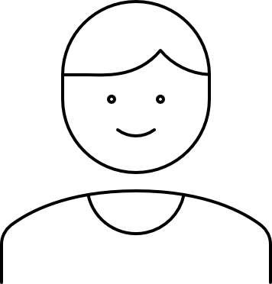
Discussion boards encourage sharing around topical issues
Live topics at the moment include the timing of school reopenings in England, with both parents and teachers expressing concerns about a June date
Children returning to school is the first step in people returning to work. At this stage they are clearly floating an idea to gauge public response. With the best will my wife and I, both still working full time from home, are not giving our five year old daughter the education and social experiences she needs. School does. And we cannot work to the best of our ability whilst also caring for her.
Male, SME owner
I think schools should stay closed until September. It’s too soon to be thinking of re opening schools. We could get a second wave of the virus. Why risk it? My daughter has said she’s not going to let her children go back until September. she could be fined but she doesn’t care. She’s happy to home school them and they’re doing ok. I don’t blame her.
Female, 60+, North
This can only work with a reduced number of pupils and staff in order to minimise the risk. Both my wife and I work in schools and have both been working some days. Kids are kids, and it is very difficult for them even if there are only a handful in school to keep to social distancing. At this stage, I would avoid against anything other than a September restart, with these dates confirmed hopefully somewhere around June so that a proper plan for each school can be outlined.
Male, Family, Mids
6

Slide 7
Discussion boards encourage sharing around topical issues
Discussions also show broad social agreement with social distancing measures, alongside concerns about the extent to which a relaxation of lockdown measures risk a ‘second wave’
I noticed when I passed the Range today whilst out for a bike ride that the carpark was almost full, most of the time I pass it is less that 1/4 full. This is in my view is evidence that people are starting to relax and slip into a false sense of security.
Male, Family, Mids
It does make sense, the majority of people are adhering to the practices, but the worry is as soon as they start lifting the restrictions we will get people who wont carry on with them and just go about as before, that is what is scary about lifting them to soon, and risk a second peak in the pandemic
Female, pre-family, South
Normal as we knew it, is quite a way away still. That said, I can see lockdown restrictions being removed slowly but surely. People will go back to work if social distancing can be maintained at a certain level, and certain ages of children will return to school. I just hope we don't do it to soon and to quickly.
Female, 60+, London
7

Slide 8
Upcoming topics
New activities launch every Friday and run for a week
Bulletin 2: Anticipating life after lockdown
Bulletin 3: Trusted information sources and attitudes to scientific expertise
Planned coverage for future weeks includes…
Attitudes to sustainability and the formation of new habits
Views on wage inequality, precarity and welfare policy
Please get in touch to discuss any topics or issues that you would like to see explored with the community in future weeks
8

Slide 9
Inside Lives offers rapid access to a rich qualitative understanding of public experiences, feelings and beliefs during the Covid-19 crisis
Measures taken to prevent the spread of Covid-19 present new challenges for policy makers needing to respond rapidly to changing conditions.
Inside Lives offers a bridge between policy-makers and those they represent at a time when face-to-face research routes have become impossible.
Inside Lives is an ongoing online community of 50 individuals to provide longitudinal qualitative insight into responses to the pandemic.
Coverage includes a diverse range of life stages and relevant circumstances – including those who have lost work, key workers in health & education and those living alone – as well as 10 SME owners drawn from a variety of sectors.
It offers fast-turnaround access to experiences, behaviours, feelings and beliefs of people living with, and looking beyond, Covid-19.
We collect insight via individual tasks to illuminate personal stories and moderated activities to deepen understanding of issues such as home-schooling, flexible working, travel, food practices, and attitudes to sustainability.
We engage participants via regular tracking measures and video diaries, alongside weekly bespoke community activities and discussions.
Participants log on twice each week for at least 30 minutes to engage with tasks, moderator probes, and other community members. Reporting is powered by our expert qualitative analysis, and brought to life via video and other multimedia material.
Alongside these free weekly bulletins, we also offer curated access to the panel on a weekly basis and bespoke analysis for your topic of interest.
Curation of the panel for one week, with custom-designed activities and outputs delivered in as little as 2-3 weeks, is available from only £8,275
In-depth analysis of non-curated weeks is available from £2,800 (excl. VAT)
Email our team to find out more

Slide 10
About Kantar
Kantar is the world’s leading evidence based insights and consulting company. We have a complete, unique and rounded understanding of how people think, feel and act; globally and locally in over 90 markets. By combining the deep expertise of our people, our data resources and benchmarks, our innovative analytics and technology, we help our clients understand people and inspire growth.
Kantar’s Public Division is the global leader in public policy research, evaluation and consultancy.
@Kantar
www.kantar.com
Nick Roberts
nick.roberts@kantar.com
07521 605 793
Amy Busby
amy.busby@kantar.com
020 7656 5949
Kantar’s Public Division UK | 4 Millbank, Westminster, London, SW1P 3JA | www.kantar.com

