Slide 1
Inside Lives Longitudinal qualitative community of citizens and small business owners
Bulletin 6 (09/06/2020)
Views on relationships, community and the relaxation of lockdown measures
Kantar’s Public Division UK

Slide 2
Inside Lives is a longitudinal qualitative study created by Kantar to offer our clients rapid access to a rich qualitative understanding of public experiences, feelings and beliefs during the COVID-19 crisis.
In this bulletin we look at Views on relationships, community and the relaxation of lockdown measures
Please get in touch to discuss any of the issues covered in this bulletin in greater depth
2

Slide 3
Community members take part in three weekly tasks
Temperature check tracking and diary activities
Thematic community activities
Topical message board discussion
Findings in this document are drawn primarily from tasks conducted in w/c 1st June

Slide 4
Trust in others to uphold measures to prevent the spread has declined
Doubts about the efforts of others to prevent the spread of coronavirus have grown across the course of the community - and although only a minority still disagree, strong negative sentiment spiked in the last week following the introduction of new measures allowing individuals to meet in groups of six outside
Switch to ‘Stay Alert’ message
Dominic Cummings news story published
Relaxation of lockdown measures
4

Slide 5
Alongside this views on response to pandemic have started to fragment
Relaxation of lockdown measures is leading to a wider interpretations of what is and isn’t acceptable, driving a growing fragmentation of views as collective agreement around risk gives ways to more mixed views based on individual factors and political views
Most participants are positive about the impact of changes on their own freedom to see people outside their household and express relief about seeing friends or being able to resume some ‘normal’ activities
However, wider views on relaxation of measures are shaped by political views about the relative prioritisation of ‘health’ vs ‘the economy’, arising from differences in beliefs about risk and social responsibility
Politically left-leaning participants or those with health concerns (including older) are more likely to continue to prioritise ‘health’ and express concern that the relaxation of measures will enable others to ignore the social distancing and risk a second peak
Politically right-leaning participants and those with immediate financial concerns are more likely to prioritise ‘the economy’ and express faith in the public to uphold measures as part of a gradual ‘commons sense’ process of relaxation
NB, these arguments are not mutually exclusive and the economy and health are typically seen as interrelated, but express relative priorities!
Please get in touch for video content
04:10
5

Slide 6
Will positive impact on immediate relationships last beyond lockdown?
Almost all participants are positive about the impact of shared lockdown situation on relationships with family, friends and neighbours – although some are asking to start questions about how much of this will last as life shifts back to normal
“
Most participants feel that the quantity (and in some cases quality) of their communications with family and friends have increased during lockdown, facilitated by an increased use of video-calling technologies – although some express concerns about the impact on elderly relatives unable to use modern communication technologies
Likewise, greater opportunities for contact and a shared sense of camaraderie are seen to have improved relationships with neighbours and the wider ‘community’
Clap for NHS was widely cited as a ritual around which local communities have congregated and some participants express concerns that renewed sense of community will fade as people return to ‘normal’ life
A small minority of participants express more negative views about the impact of lockdown on community relationships, with the increased sense of proximity exacerbating existing tensions
I think I have had more time to make those catch up calls without the hectic regime of school runs, clubs and activities. Group chats with groups of friends have been wonderful uplifting and more regular intervals than we would have managed with non lock down busy diaries. Less immersed in our own routine and more time to find out about others
Female, Family, Midlands
At first I think there was a tremendous 'in this together' feeling, however now that time has worn on and the guidelines have changed it feels a little more like people are returning to their slightly more selfish ways, litter left in the parks for others to clear up, police having to tackle petty theft and joyriding.
Male, Family, North
6

Slide 7
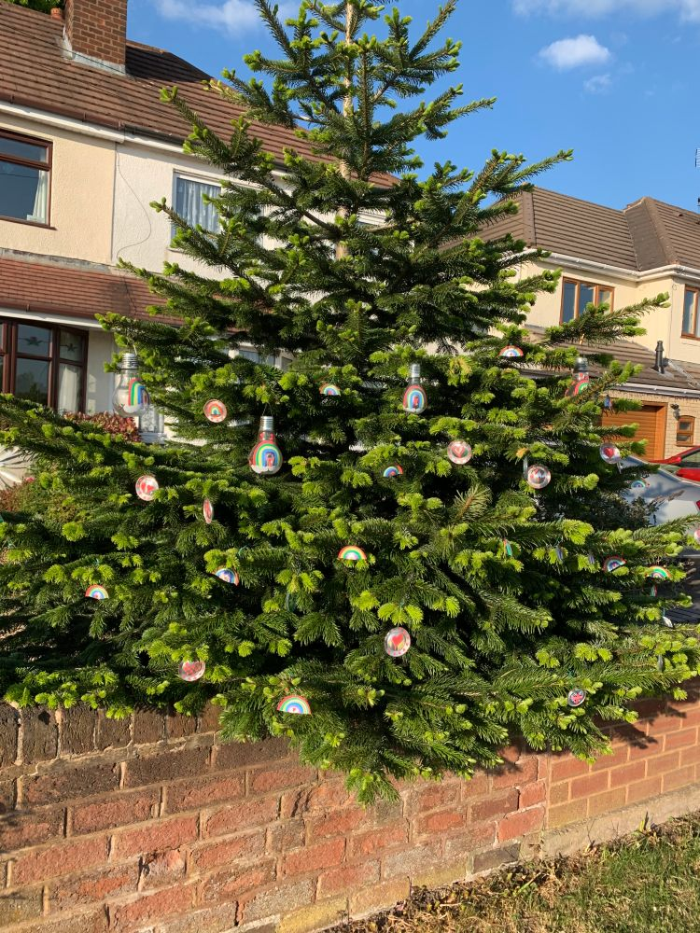
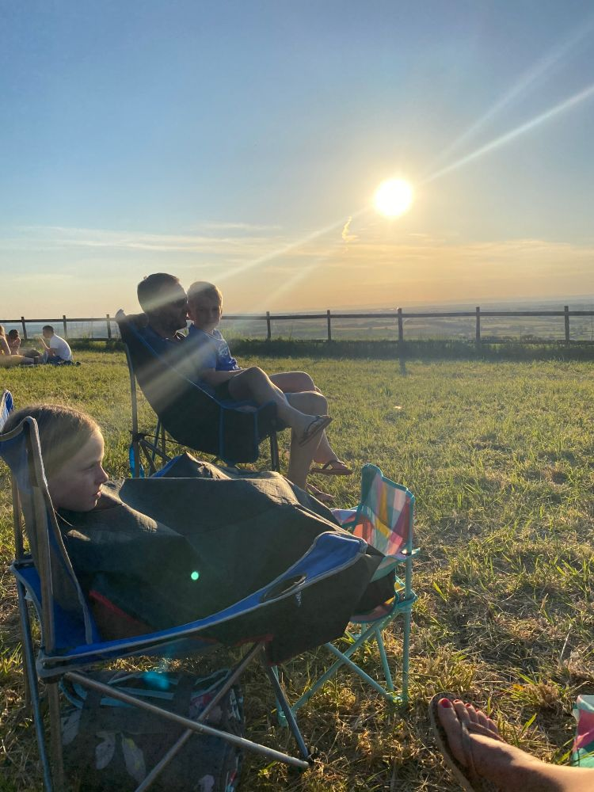
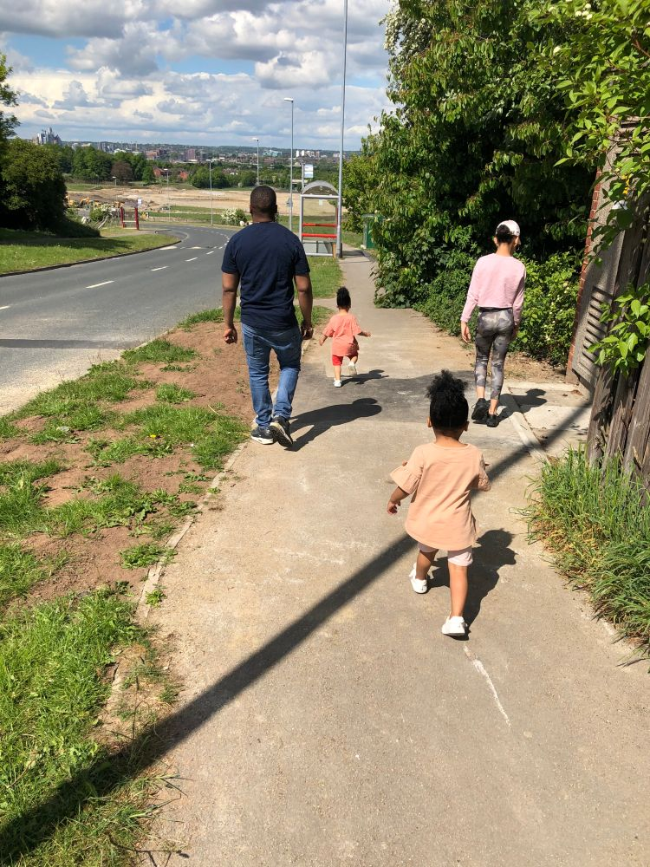
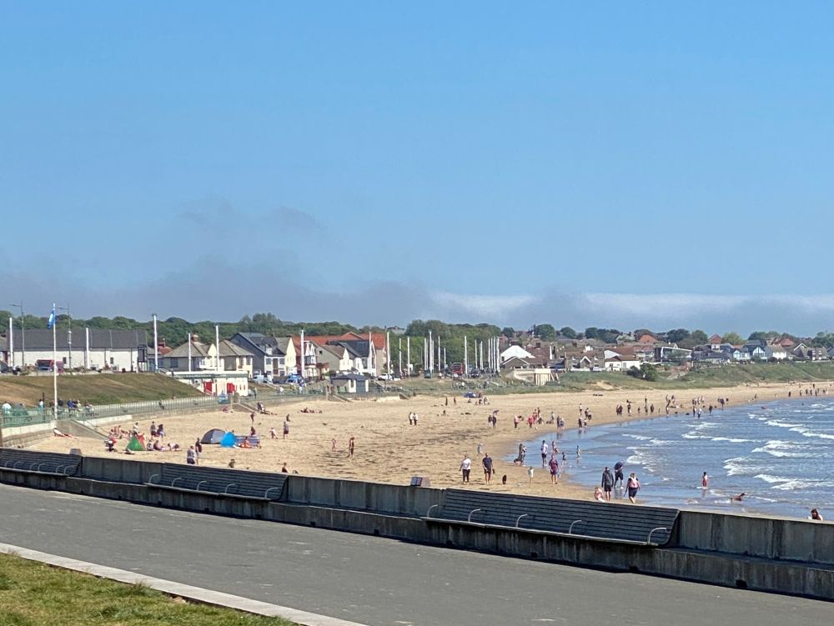
Participants were asked to share images of their local areas
Themes include community engagement, the enjoyment of communal green spaces for those that have access, and concerns about increased crowding
“Children have been involved in making ornaments of appreciation for the NHS.”
We have found so many new places to walk to, cycle to and visit in lockdown
Staying home, local walks around the block. Apart from that it’s Asda and home again
This was my local beach at 10am today...........! I am shielding at home, however my husband took these this morning.
7

Slide 8
Upcoming topics
New activities launch every Friday and run for a week
Bulletin 7: The return to education and life with social distancing
Bulletin 8: Attitudes and expectations for flexible working post-pandemic
Planned coverage for future weeks includes…
Health inequalities and the impact on experiences of the pandemic
Please get in touch to discuss any topics or issues that you would like to see explored with the community in future weeks
8

Slide 9
Inside Lives offers rapid access to a rich qualitative understanding of public experiences, feelings and beliefs during the Covid-19 crisis
Measures taken to prevent the spread of Covid-19 present new challenges for policy makers needing to respond rapidly to changing conditions.
Inside Lives offers a bridge between policy-makers and those they represent at a time when face-to-face research routes have become impossible.
Inside Lives is an ongoing online community of 50 individuals to provide longitudinal qualitative insight into responses to the pandemic.
Coverage includes a diverse range of life stages and relevant circumstances – including those who have lost work, key workers in health & education and those living alone – as well as 10 SME owners drawn from a variety of sectors.
It offers fast-turnaround access to experiences, behaviours, feelings and beliefs of people living with, and looking beyond, Covid-19.
We collect insight via individual tasks to illuminate personal stories and moderated activities to deepen understanding of issues such as home-schooling, flexible working, travel, food practices, and attitudes to sustainability.
We engage participants via regular tracking measures and video diaries, alongside weekly bespoke community activities and discussions.
Participants log on twice each week for at least 30 minutes to engage with tasks, moderator probes, and other community members. Reporting is powered by our expert qualitative analysis, and brought to life via video and other multimedia material.
Alongside these free weekly bulletins, we also offer curated access to the panel on a weekly basis and bespoke analysis for your topic of interest.
Curation of the panel for one week, with custom-designed activities and outputs delivered in as little as 2-3 weeks, is available from only £8,275
In-depth analysis of non-curated weeks is available from £2,800 (excl. VAT)
Email our team to find out more

Slide 10
About Kantar
Kantar is the world’s leading evidence based insights and consulting company. We have a complete, unique and rounded understanding of how people think, feel and act; globally and locally in over 90 markets. By combining the deep expertise of our people, our data resources and benchmarks, our innovative analytics and technology, we help our clients understand people and inspire growth.
Kantar’s Public Division is the global leader in public policy research, evaluation and consultancy.
@Kantar
www.kantar.com
Nick Roberts
nick.roberts@kantar.com
07521 605 793
Amy Busby
amy.busby@kantar.com
020 7656 5949
Kantar’s Public Division UK | 4 Millbank, Westminster, London, SW1P 3JA | www.kantar.com

